Slide 1
Practical Application of SFIA in Software Engineering
Complementing SWEBOK with Industry-Driven Skills and Competencies
Peter Leather, Global Lead, SFIA Foundation
Project manager for SFIA versions 7,8 and 9
Develop industry mappings, and education and guidance material for SFIA Users and collaborations with Industry partners

Slide 2

Topics for today
Introduction to the SFIA Framework and the SFIA Foundation
Software engineering and SFIA
Complementary nature of SWEBOK and SFIA
How SFIA is used by employers and employees
Resources referenced today will be available via a ‘Quick Links’ page on the SFIA website dedicated to Software Engineering, SWEBOK and SFIA. Use the link or QR code below.
https://bit.ly/swebok_summit_sfia

Slide 3
About SFIA*
“To enable greater capability and capacity within the workforce.”
The SFIA Framework
The SFIA Foundation
Describes skills, competencies and behavioral factors and a broad range of technology and digital disciplines including software engineering
Provides a common language
A freely accessible, shared resource for employers, individuals, educators, and professional bodies
Community-driven development and open collaboration
Technology- and vendor-neutral
Widely used, available in 12 languages
Exceptionally lean, global, non-commercial, not-for-profit overseeing the SFIA framework
Operates with minimal overhead, reinvesting all proceeds into framework development and community support
Facilitate a global ecosystem – this has grown steadily over time
Sources funding to keep the framework open and freely accessible to employers and individuals
  (This is not easy!)
* Skills Framework for the Information Age
Notes:
SFIA stands for Skills Framework for the Information Age
Probably wouldn’t call it that now – but the name Sophia has stuck so we don’t want to change it
Will be talking a lot about the framework – but need to give a background to the Foundation

Slide 4
SFIA evolution – 25 years
SFIA Launch
SFIA v3
SFIA v5
SFIA v7
SFIA v9
2000
2024
SFIA v2
SFIA v4
SFIA v6
SFIA v8
Field-tested approach over 20+ years: Used by practitioners, not a theoretical model
Established update process: Regular revisions with contributors, design authority, beta testing, structured releases and translations
Global adoption: Across government, corporate, and education sectors in 12 languages
Expanding resources over time: Growing guidance materials and industry partnerships
Organic growth: Primarily spread through word-of-mouth success
Notes:
A model is always a hypothesis—all models are wrong, some are useful—and our job is to progressively validate and refine it

Slide 5
Evolving the SWEBOK / SFIA mapping
2012
  Initial partnership – IEEE-CS & SFIA Foundation
2018
Major update to SFIA - New and updated skills/skill levels included in SFIA v7 to aligned with SWEBOK v3 KAs
A software engineering competency model based on SWEBOKv3 and SFIA v7 published
2016
  Mapping SFIA to SWEBOK v3 knowledge areas [also Mapping SFIA to the EITBOK knowledge areas]
2024
  New and updated skills/skill levels included in SFIA v9 for software engineering skills
2014
  Mapping SFIA v5 to SWECOM skill areas and SWECOM levels
2017-18
  IEEE-CS PEAB sponsored project to harmonize the SWECOM onto SFIA skills and SFIA levels
2021
  Refreshed mapping of SWEBOK v3 to SFIA v8 (no major changes)
2025
  Update mapping - SFIA 9 aligned to SWEBOK v4. Significant update to match SWEBOK v4 new KAs (e.g., Software Engineering Operations) and related disciplines

Slide 6
SFIA is a broad framework – built on a common structure
Within the scope of SFIA are the skills needed by many of the world's most in-demand occupations, including professionals working in fields such as…
Data science, analytics, machine learning & AI
IT & ICT
Digital transformation
Information and cyber security
Software engineering
Procurement and technology finance
Applied computing and computational science
Portfolio, programme and project management
User centred design
SFIA applies a common structure to many domains – supporting multidisciplinary teams, varied career paths and integrated workforce planning.
Business change
Human resource and workforce management
Learning and education
Digital product development, sales and marketing
Notes:
One of the major benefits of SFIA is that it provides a common vocabulary and language for describing skills and competencies in a way that is completely agnostic about specific technologies or proprietary methods or tools.
Rather than trying to describe complete jobs or roles, SFIA describes the skills needed for a vast range of crucial jobs in the digital economy – some of the areas covered are shown in the figure on the right.
Jobs in each of these areas will need two or more SFIA skills, typically 5 - 7. The ability to combine skills to describe a job or role contributes to the power of SFIA.
SWEBOK v4 increased in scope – SFIA skills for the new KAs were already there

Slide 7
SFIA is a broad skills framework – built on a common structure
Strategy and architecture |  | Change and transformation |  | Development and implementation |  | Delivery and operation |  | People and skills |  | Relationships and engagement
These categories can be used to navigate the framework
SFIA v9 has detailed definitions of 147 professional skills spanning a range of technical, digital, business and management disciplines

Slide 8
SFIA is a broad skills framework – built on a common structure
Strategy and architecture |  | Change and transformation |  | Development and implementation |  | Delivery and operation |  | People and skills |  | Relationships and engagement
Strategy and planning |  | Change implementation |  | Systems development |  | Technology management |  | People management |  | Stakeholder management
Financial and value management |  | Change analysis |  | Data and analytics |  | Service management |  | Skills management |  | Sales and bid management
Security and privacy |  | Change planning |  | User centred design |  | Security services |  |  |  | Marketing
Governance, risk and compliance |  |  |  | Content management |  | Data and records operations
Advice and guidance |  |  |  | Computational science
9
5
19
11
6
6
8
5
9
10
7
3
5
6
6
7
6
6
4
3
3
3
Software Engineering related skills are found in several categories and subcategories

Slide 9
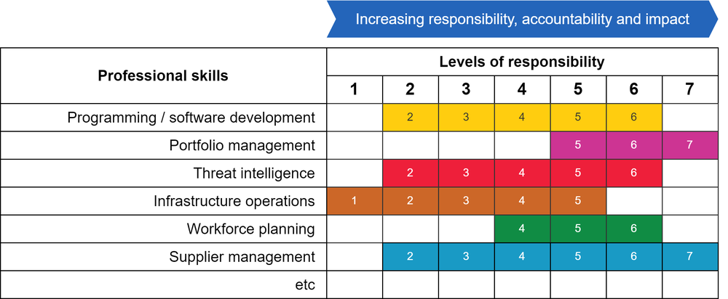
Each of the Professional skills is defined at up to 7 levels of responsibility
Examples of range of skills
Consistent 7 levels for all skills
SFIA levels describe workplace responsibilities, accountabilities and impact
(e.g., not years of experience or technical expertise)

Slide 10



How SFIA is typically used…. for employers and employees
Employer focus
Employee focus
Work Decomposition: Break down business needs into skills and capabilities.
Role Definition: Identify tasks / activities / responsibilities and skills. Recruitment and team management.
Jobs/Skills Matrix: Map skills to job roles with consistent language and levels (skills matrix).
Resource deployment: Task and project assignments.
Assess employees’ performance and skills.
Professional development: Provide career paths, training, mentoring and work experiences.
Self assessment: Assess their own performance based on real workplace accomplishments.
Build a portfolio of experience: aligned to SFIA’s skill& level definitions.
Identify and implement growth opportunities: work experiences, career progression options, mentoring, training.
Career progression: Internal promotions or lateral moves into different domains.

Slide 11
Some examples of SFIA in use…
Australian Public Service Digital Transformation Agency – Career pathfinder for career navigation and job-matching
NICE Framework (USA) – levels of professional competency complementary to their cybersecurity work roles framework
University of Strathclyde – Software development apprenticeships embedding SFIA in work-based learning
Royal Air Force (UK) – a structured, professionalized framework to manage and develop skills across their workforce.
Professional Standards – e.g. ACS, BCS, IITPSA, CIPS, ISACA, ISC2, Comptia

Slide 12
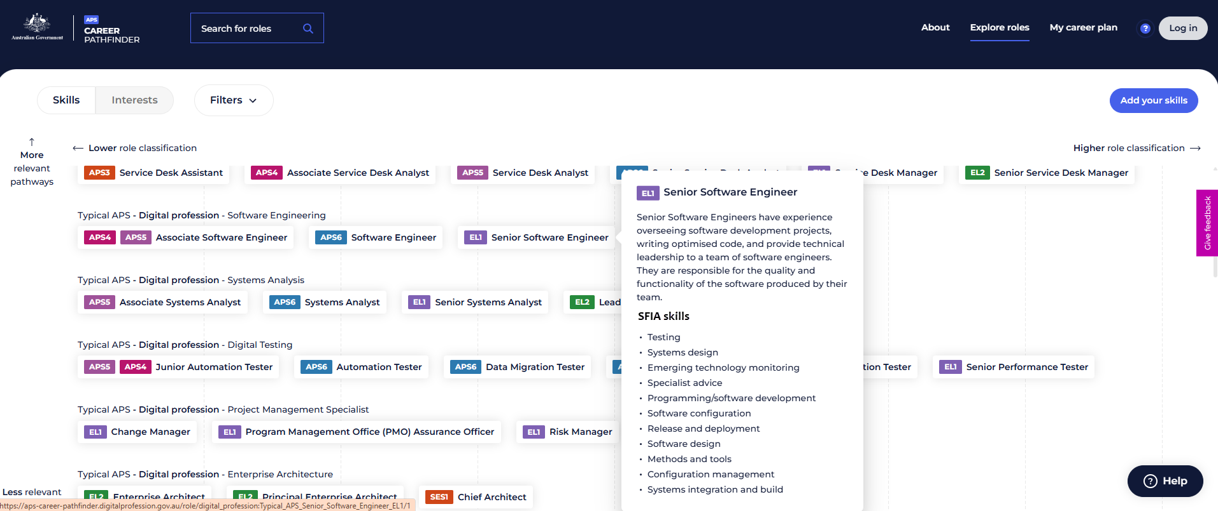
Australian Public Service (APS) – Career Pathfinder
You can find roles that match your skills. Or roles that match your interest.
You can see what skills you need and how to get them. The tool shows you:
descriptions of what the role does, in some case there are profiles of people doing jobs with that role now
details of the required skills
training specific to your skill needs
APS Jobs to show you available jobs.

Slide 13
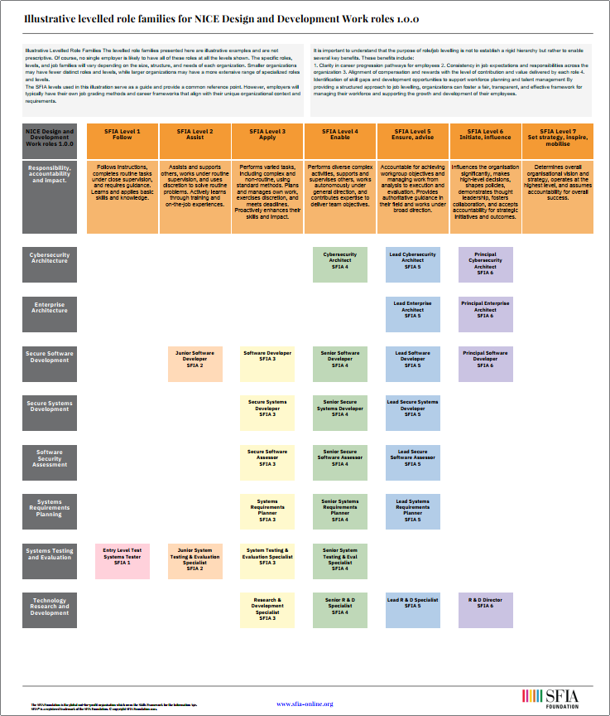
Visualizing career paths with SFIA
The US Government NICE Workforce Framework for Cybersecurity
The Workforce Framework for Cybersecurity, commonly referred to as the NICE Framework, is a nationally focused resource to help employers develop their cybersecurity workforce. It establishes a common lexicon that describes cybersecurity work and workers regardless of where or for whom the work is performed. The NICE Framework applies across public, private, and academic sectors.
The NICE program of the National Institute for Standards and Technology (NIST) released NICE Framework Components v1.0.0 in March 2024.

Slide 14
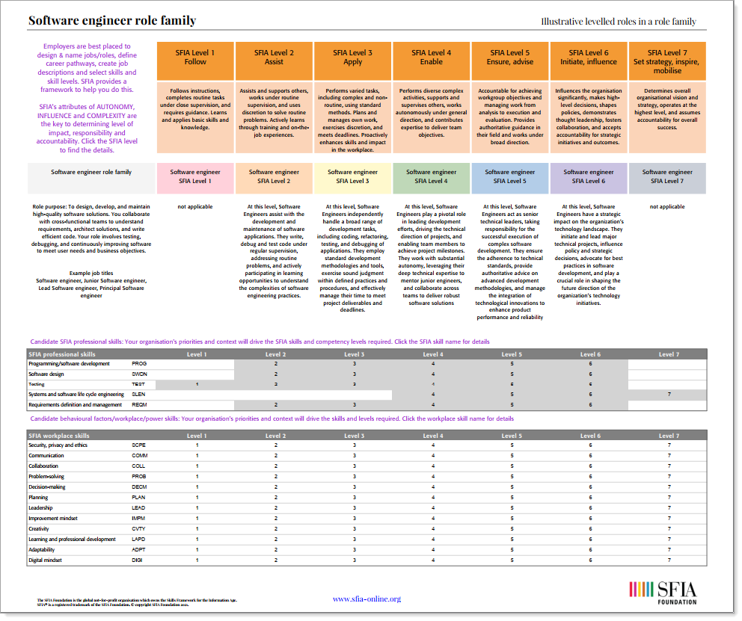
Visualising software engineer career paths with SFIA

Slide 15
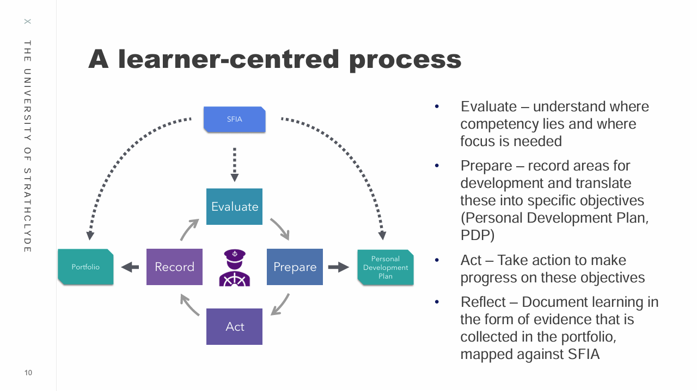
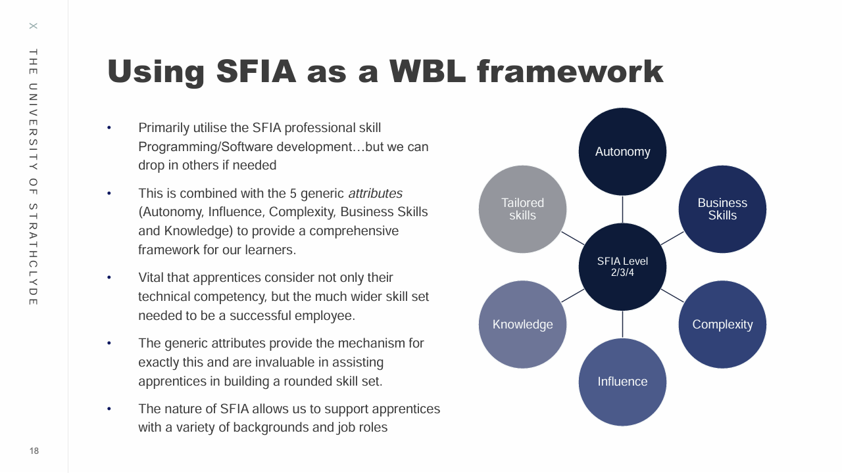
Work-based Learning
University of Strathclyde
Developed and runs an innovative approach to work-based learning (WBL) in their graduate and degree apprenticeship programmes, using SFIA to provide structure and progression paths for apprentices.
Their model:
Combines academic study with workplace experience
Uses SFIA to structure skills development and competency assessment
Employs innovative assessment methods including the STARC framework
Provides early career exposure to industry-standard frameworks
Develops both technical and professional skills

Slide 16

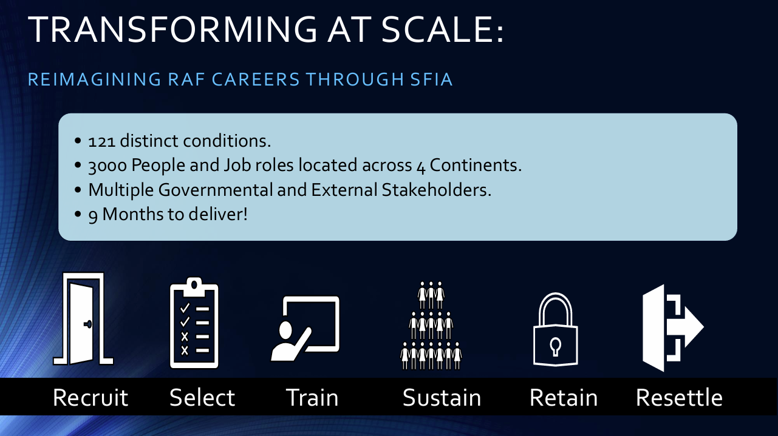
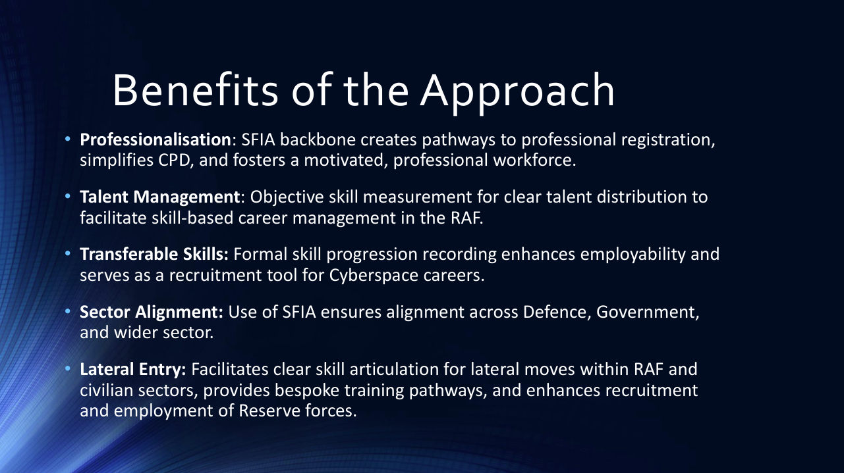
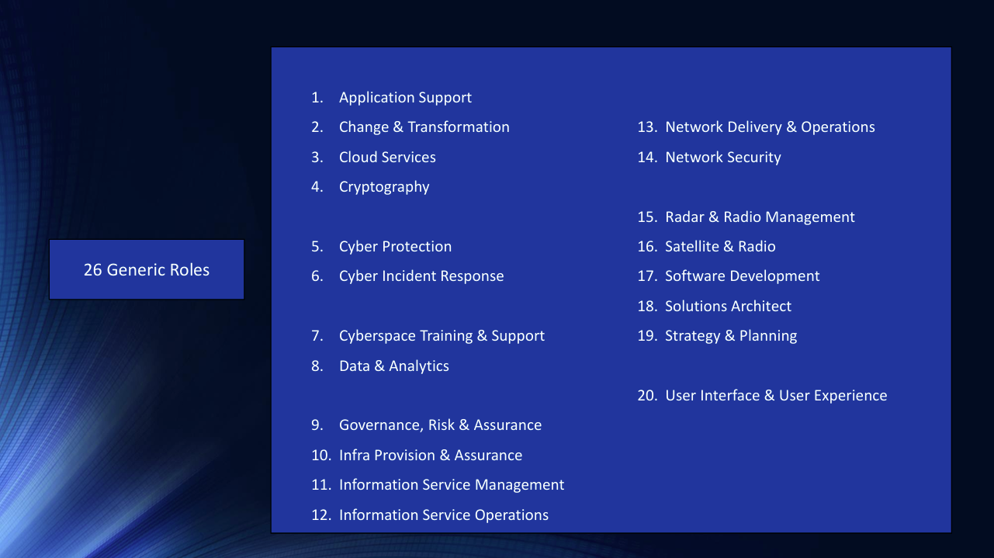
The RAF Cyber Space Profession uses SFIA to create a structured, professionalized framework to manage and develop skills across their workforce.
The RAF is the UK's air force. It works with partners around the world to respond to threats, prevent conflict, watch the skies, and combat cyber threats.

Slide 17
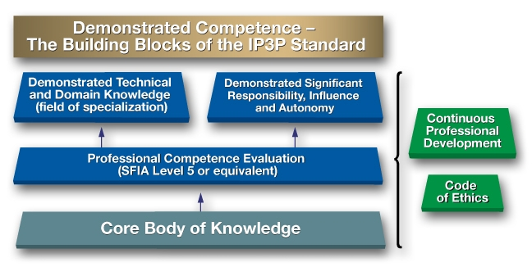
Some SFIA Partners
IEEE-CS, IET, IITPSA - Institute of IT Professionals South Africa, CIPS - Canadian Information Processing Society, BCS - The Chartered Institute for IT, Australian Computer Society, ISACA, ISC2, SANS, Institute of IT Professionals New Zealand, IT Promotion Agency Japan, CIISec, CREST, itSMF International
Professional Standards
Key Features of the IP3P standard
The IP3P is the IP3 accreditation standard that is used to assess an organization’s professional standard. It applies to the professional certification program and not to individuals.
The Skills Framework for the Information Age (SFIA) (or equivalent) is the reference document for establishing the minimum professional standard of competence.
The professional autonomy and responsibility level has been set at SFIA Level 5 (or equivalent or above).
https://www.ipthree.org/gain-ip3-accreditation/ip3-accreditation-program/it-professional-standards/

Slide 18


How the SFIA framework works

Slide 19
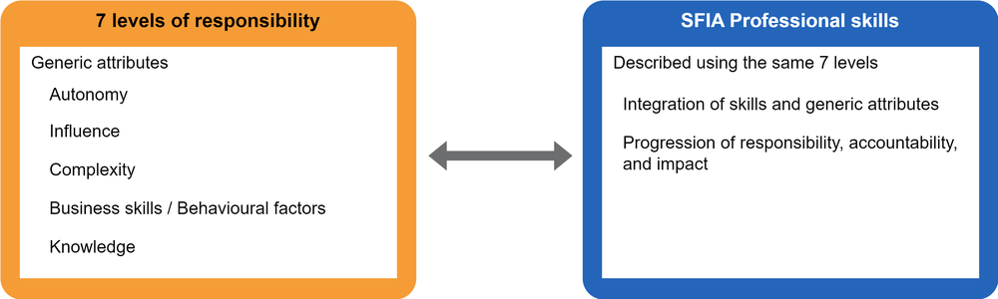
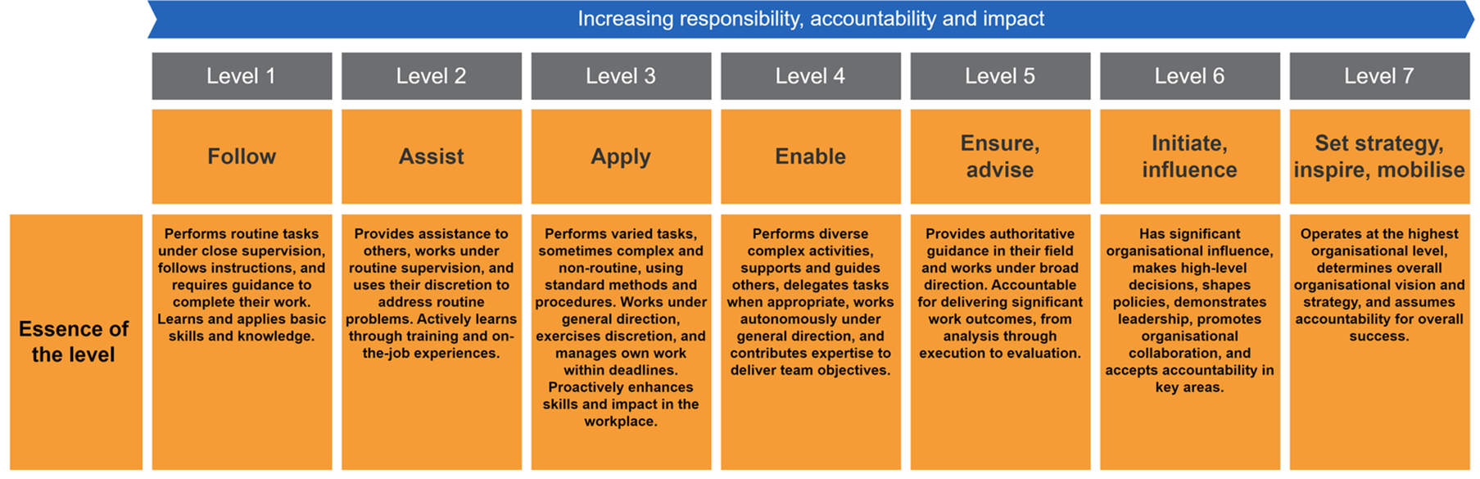
Consistent 7 levels for all skills
SFIA levels describe workplace responsibilities, accountabilities and impact
(not e.g., years of experience or technical expertise)

Slide 20
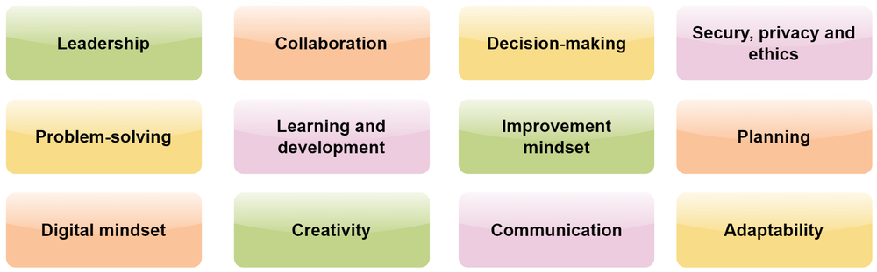
Business skills/behavioral factors*
*Also called soft skills, workplace skills, durable skills amongst other names
… all described at 7 levels
“success in technology-related roles requires not just technical proficiency, but also the ability to navigate complex business environments”

Slide 21
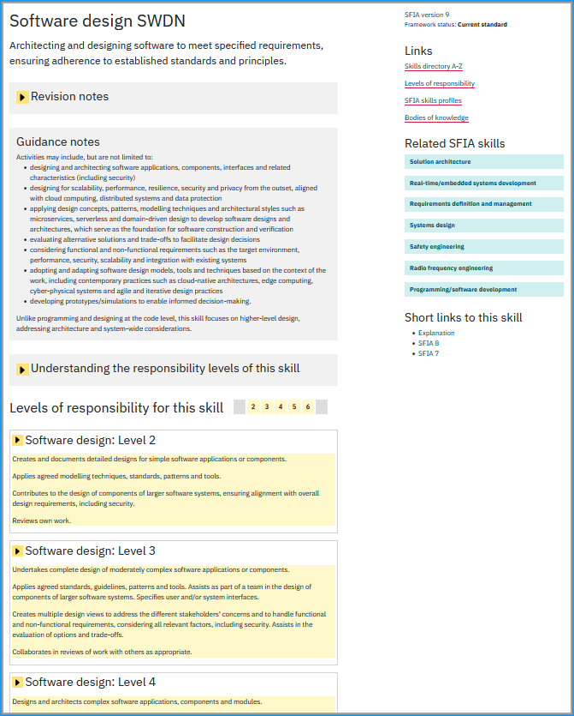
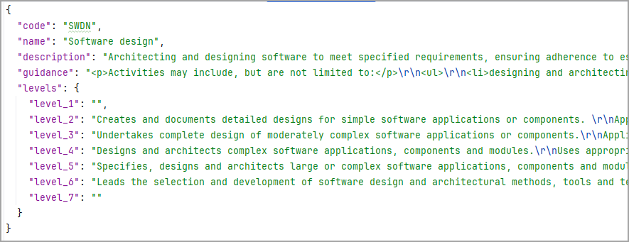
https://sfia-online.org/en/skillcode/SWDN
Each SFIA skill has a full description
… SFIA is published in a range of formats
Web pages
2 pdf documents (content and “How to” guide)
One page summary chart
Excel download
JSON – via SFIA API (great for GenAI use)
RDF / ttl (knowledge graphs/embeddings)
Skill name and code
Version
Short skill description
Guidance notes for application of the skill
Related skills and links to other resources
Skill at a responsibility level
Notes:
Published in different formats to make it easier to consume
Web pages are the starting point and we use them to provide additional links and resources to support the understanding use of SFIA
We need to keep legacy version available as employers can take some time to migrate to newer versions
Excel version helsp to support internal tooling, many employers link directly to web pages
We have an API of the skills – JSON format is great for GenAI use/Retrieval Augmented Generation
RDF/ttl growing in demand for Retrieval Augmented Generation/knowledge graphs/embeddings

Slide 22
Increasing responsibility, accountability, impact
 | Junior software engineer | Software engineer | Senior software engineer | Lead software engineer | Principal engineer
 | SFIA levels for each skill
Programming/software development (PROG) | 2 | 3 | 4 | 5 | 6
Software design (SWDN) |  | 2 | 3 | 4
Functional testing (TEST) | 1 | 2 | 3 | 4
Systems integration and build (SINT) | 2 | 3 | 4 | 5 | 6
Systems development management (DLMG) |  |  |  | 5 | 6
Specialist advice (TECH) |  |  | 4 | 5
Flexibility by design - employers name jobs and match skills to their jobs
SFIA describes skills not job titles
Illustrative job titles and skills and skill levels
Job roles combine multiple SFIA skills
Notes:
Job roles combine multiple SFIA skills
Typically, 5 to 7 (sometimes fewer) at different levels rather than mapping a job role 1:1 to a skill
Flexibility by design
The same job title in different employers can contain different skill and level combinations
Skills vs. roles
SFIA defines capabilities (skills), not organizational positions (job titles)
Level indicates responsibility
SFIA levels reflect responsibility, accountability and impact, not years of experience or technical expertise
Context is key
Skills are practiced differently depending on industry and technical domain

Slide 23
SFIA levels describe increasing responsibility, accountability and impact
Programming/software development: Level 3
Programming/software development: Level 4
Programming/software development: Level 5
Levels of responsibility – the same for all SFIA skills
Level 3 - Apply: Essence of the level: Performs varied tasks, sometimes complex and non-routine, using standard methods and procedures. Works under general direction, exercises discretion, and manages own work within deadlines. Proactively enhances skills and impact in the workplace.
Level 4 - Enable: Essence of the level: Performs diverse complex activities, supports and guides others, delegates tasks when appropriate, works autonomously under general direction, and contributes expertise to deliver team objectives.
Level 5 - Ensure, advise: Essence of the level: Provides authoritative guidance in their field and works under broad direction. Accountable for delivering significant work outcomes, from analysis through execution to evaluation.
SFIA skill definition – unique for each skill – but all aligned to the generic levels
Designs, codes, verifies, tests, documents, amends and refactors moderately complex programs/scripts.
Applies agreed standards, tools and security measures to achieve a well-engineered result.
Monitors and reports on progress. Identifies issues related to software development activities. Proposes practical solutions to resolve issues.
Collaborates in reviews of work with others as appropriate.
Designs, codes, verifies, tests, documents, amends and refactors complex programs/scripts and integration software services.
Contributes to the selection of the software development methods, tools, techniques, and security practices.
Applies agreed standards, tools, and security measures to achieve well-engineered outcomes.
Participates in reviews of own work and leads reviews of colleagues' work.
Takes technical responsibility across all stages and iterations of software development.
Plans and drives software construction activities. Adopts and adapts appropriate software development methods, tools and techniques.
Measures and monitors applications of project/team standards for software construction, including software security.
Contributes to the development of organisational policies, standards and guidelines for software development.
Notes:
Make better judgment calls about architectural approaches
Understand the systemic consequences of design decisions
Take responsibility for design outcomes across the development lifecycle
Navigate complex stakeholder needs and technical constraints
This perspective helps explain why the progression through SFIA levels isn't simply about doing more complex tasks, but about taking broader responsibility, making more consequential choices, and understanding deeper systemic impacts.
Not about managing people or teams – TECHNICAL RESPONSIBILITY, ACCOUNTABILITY AND IMPACT – decisions made, larger riskier projects/developments, complexity (including e.g managing stakeholders demands)

Slide 24
SFIA Skill name | Level 1 | Level 2 | Level 3 | Level 4 | Level 5 | Level 6 | Level 7
Requirements definition and management REQM |  | 2 | 3 | 4 | 5 | 6
Systems design DESN |  | 2 | 3 | 4 | 5 | 6
Software design SWDN |  | 2 | 3 | 4 | 5 | 6
Programming/software development PROG |  | 2 | 3 | 4 | 5 | 6
Systems integration and build SINT |  | 2 | 3 | 4 | 5 | 6
Real-time/embedded systems development RESD |  | 2 | 3 | 4 | 5 | 6
Methods and tools METL |  | 2 | 3 | 4 | 5 | 6
Configuration management CFMG |  | 2 | 3 | 4 | 5 | 6
Functional testing TEST | 1 | 2 | 3 | 4 | 5 | 6
Non-functional testing NFTS | 1 | 2 | 3 | 4 | 5 | 6
Release management RELM |  | 2 | 3 | 4 | 5 | 6
Deployment DEPL |  | 2 | 3 | 4 | 5 | 6
Quality assurance QUAS |  | 2 | 3 | 4 | 5 | 6
Measurement MEAS |  | 2 | 3 | 4 | 5 | 6
Safety engineering SFEN |  | 2 | 3 | 4 | 5 | 6
Systems development management DLMG |  |  |  | 4 | 5 | 6 | 7
Systems and software lifecycle engineering SLEN |  |  | 3 | 4 | 5 | 6 | 7
Project management PRMG |  |  |  | 4 | 5 | 6 | 7
Product management PROD |  | 2 | 3 | 4 | 5 | 6
Safety assessment SFAS |  |  |  | 4 | 5 | 6
Business situation analysis BUSA |  | 2 | 3 | 4 | 5 | 6
Feasibility assessment FEAS |  | 2 | 3 | 4 | 5 | 6
User experience design HCEV |  | 2 | 3 | 4 | 5 | 6
Solution architecture ARCH |  |  |  | 4 | 5 | 6
Data modelling and design DTAN |  | 2 | 3 | 4 | 5
Change control CHMG |  | 2 | 3 | 4 | 5 | 6
Incident management USUP | 1 | 2 | 3 | 4 | 5 | 6
Problem management PBMG |  | 2 | 3 | 4 | 5
Portfolio management POMG |  |  |  |  | 5 | 6 | 7
Investment appraisal INVA |  |  |  | 4 | 5 | 6
Stakeholder relationship management RLMT |  |  |  | 4 | 5 | 6 | 7
Resourcing RESC |  | 2 | 3 | 4 | 5 | 6
Supplier management SUPP |  | 2 | 3 | 4 | 5 | 6 | 7
Contract management ITCM |  | 2 | 3 | 4 | 5 | 6 | 7
Financial management FMIT |  |  |  | 4 | 5 | 6
Like SWEBOK's Knowledge Areas, SFIA covers a comprehensive range of software engineering tasks, activities, and responsibilities
An extract of Software Engineering related skills in SFIA v9
Notes:
A wide range of software engineering relate skills
SWEBOK v9 has grown in scope – SFIA skills for this KA were already there
Like SWEBOK – SFIA is neutral to what tools are being used. This is by design . Employers can map their tools/technologies to the SFIA skills
SFIA skill
Tasks and activities (shortened)
Example tools / languages / environments
Programming/software development (PROG)
Write, test, and document code
Python, Java, C++, VS Code, IntelliJ, GitHub Codespaces
Software design (SWDN)
Design software structure and components
UML tools, Enterprise Architect, PlantUML, Icepanel, Diagramming tools
Functional testing (TEST)
Design and execute software tests
JUnit, Selenium, Postman, PyTest, Cypress
Non-functional testing (NFTS)
Test performance, usability, reliability
JMeter, LoadRunner, Lighthouse
Configuration management (CFMG)
Manage source code and config items
Git, GitLab, Subversion, Mercurial
Software configuration (PORT)
Package, build and configure software
Docker, Ansible, Kubernetes, Helm, Make, Maven
Deployment (DEPL)
Deploy and release software
Jenkins, GitHub Actions, ArgoCD, Octopus Deploy
Systems integration and build (SINT)
Integrate and build software systems
Bazel, Gradle, Azure DevOps, CircleCI
Systems software administration (SYSP)
Administer software platforms and runtimes
Linux CLI, PowerShell, Windows Admin Centre, systemd

Slide 25
SWEBOK & SFIA in the professional working environment
Shift of focus from "what you know" to "what you can do"
SFIA is used by a wide range of employers: public and private sector, different industries, different sizes
Knowledge
Activities/
Tasks
Outputs
/Outcomes
Business results
SWEBOK
The SFIA skills related to the core software engineering KAs are the most visited on the SFIA website
SFIA
Knowing facts, principles, and theory
Applying knowledge and skills consistently, professionally, independently in a work environment.

Slide 26
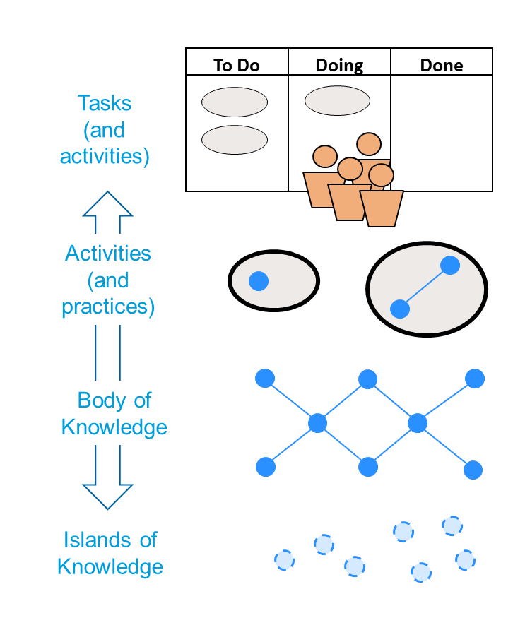
SWEBOK / SFIA
mapping
SWEBOKv4 content
Some purely Knowledge-based descriptions:
  Focus on understanding principles, methods, or theories.
  Relevant for learning foundational concepts.
  Example: "Requirements validation ensures alignment with stakeholder needs."
Some explicitly described Tasks and Activities:
  Provide direct, actionable steps or processes.
  Bridge the gap between theoretical knowledge and practical application.
  Example: "This includes selecting or developing the facilities, hardware, software, firmware, and procedures to conduct the testing activity.“
Some inferred Tasks and Activities:
  Describe outcomes or objectives indirectly linked to actions.
  Leave flexibility for implementation.
  Example: section 2.2.7. Non-functional Testing implies several non-functional testing tasks.
SFIA skill descriptions describe workplace tasks, activities and responsibilities.
This forms the basis of the mapping to SWEBOK KA’s and related disciplines. It is not a mapping of knowledge only.
The mapping is not 1:1 SFIA skill to KA.
The mapping is a loose coupling for informative purposes.
Content from SWEBOK is not copied into SFIA.
Credit: Hironori Washizaki

Slide 27
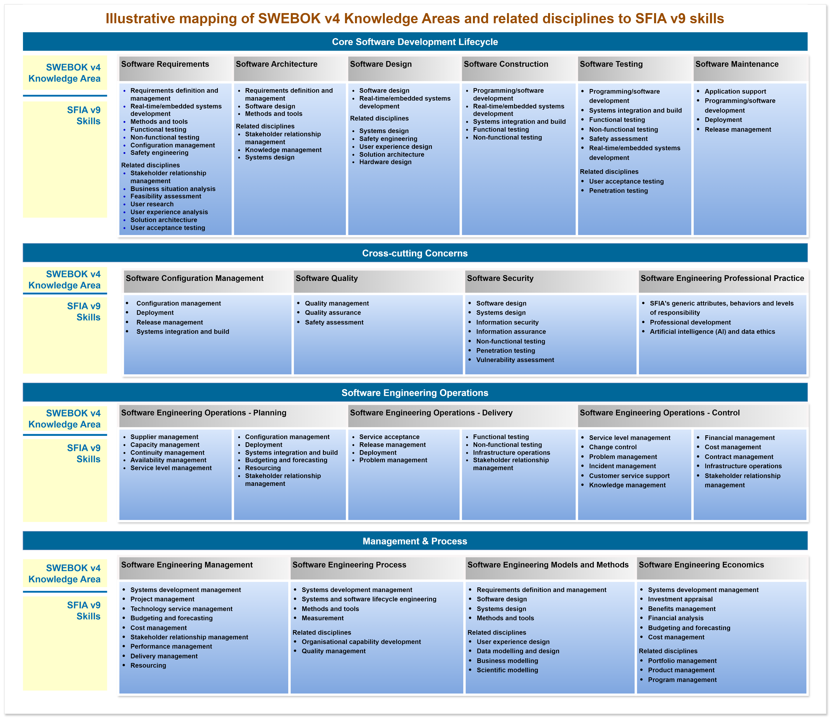
SWEBOK v4 to SFIA v9
A broad mapping to illustrate related disciplines

Slide 28
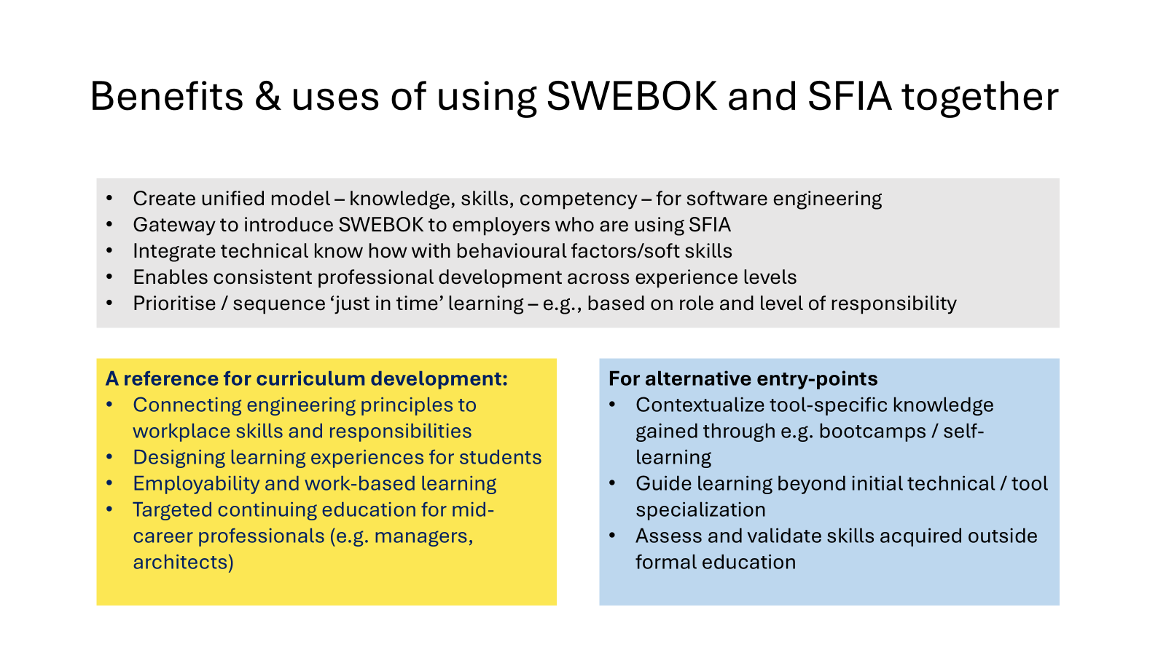
Benefits & uses of using SWEBOK and SFIA together
Create unified model – knowledge, skills, competency – for software engineering
Gateway to introduce SWEBOK to employers who are using SFIA
Integrate technical know how with behavioural factors/soft skills
Enables consistent professional development across experience levels
Prioritise / sequence ‘just in time’ learning – e.g., based on role and level of responsibility
A reference for curriculum development:
Connecting engineering principles to workplace skills and responsibilities
Designing learning experiences for students
Employability and work-based learning
Targeted continuing education for mid-career professionals (e.g. managers, architects)
For alternative entry-points
Contextualize tool-specific knowledge gained through e.g. bootcamps / self-learning
Guide learning beyond initial technical / tool specialization
Assess and validate skills acquired outside formal education

Slide 29
Any questions and ideas?
https://bit.ly/swebok_summit_sfia
Use the link or the QR code for resources related to SFIA and SWEBOK:SFIA mapping resources are available to explore in more detail
Email: updates@sfia-online.org

